Slide 1
Building The Quadcopter Schematic

Slide 2
Schematics Goals
Determine what components your PCB will hold
Define the electrical connectivity between those components
Specify some metadata about the parts

Slide 3
Schematic Example
open /Users/swanson/UCSD/Teaching/18sp-190/QuadClass-Resources/Lecture\ Slides/Examples/ATmega128RFA1-DevBoard/ATmega128RFA1-DevBoard.sch

Slide 4
Eagle Pitfalls
Always edit schematics with your grid set to 0.1” or 0.05” – ALWAYS!!!
Wires/pins can look connected but not be.
‘Wiggle’ parts to make sure wires move with them.
Check for the green dot.

Slide 5
Electrical Rules Check
This checks for common problems in schematics.
Make sure you understand the reason for the errors.
Fix them if you can.
Run it!

Slide 6
Building The Quadcopter Schematic

Slide 7

What You Will Build

Slide 8
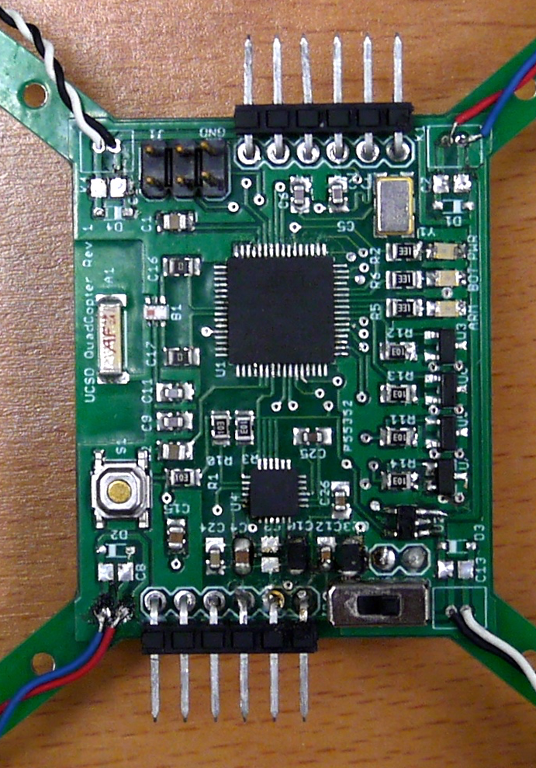
What You Will Build

Slide 9
Three Schematic Design Skills
Copy – You will manually copy the microcontroller circuit from the remote.
Copy – you’ll copy the motor controller based on a schematic I provide.
Implement – You will look at the data sheet for the IMU and voltage regulator and implement the design it provides.
Design – you will add some LEDs to your design on your own.

Slide 10
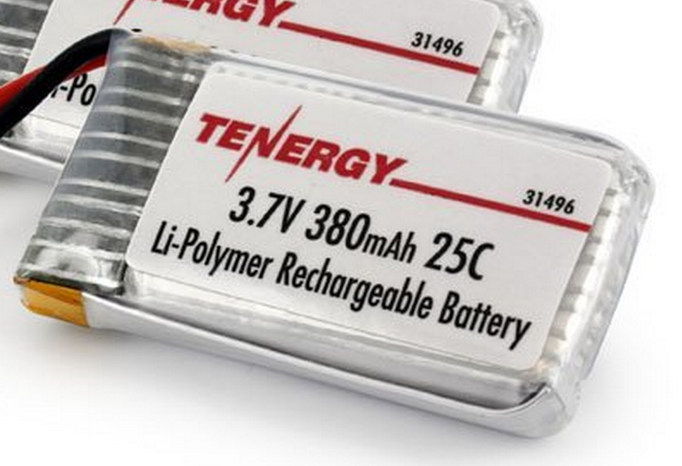
Power Supply
Lithium Polymer Battery
370 Mah
Max 9.25 Amps
Nominal voltage = 3.7-4.2V
Powers the motors directly
3.3V low dropout (LDO) voltage regulator
Powers the microcontroller and the IMU

Slide 11
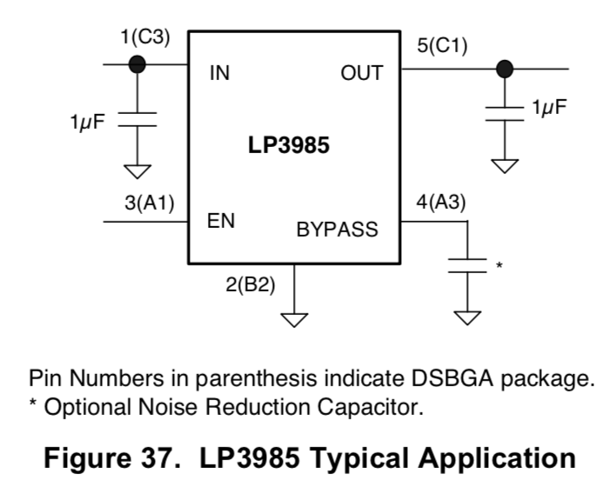
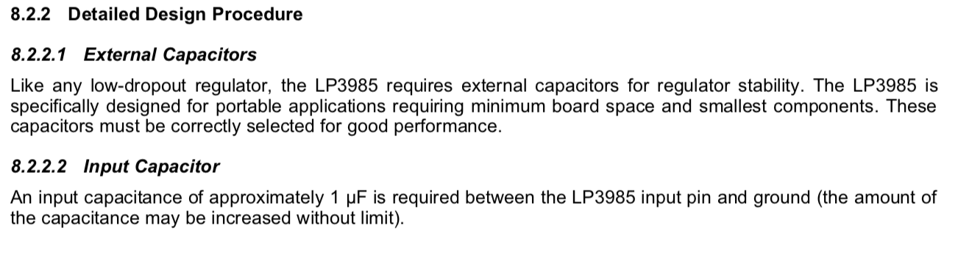
Regulator Datasheet

Slide 12
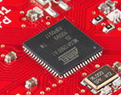
Flight Computer
ATmega128RFA1 microcontroller
Arduino compatible
16Mhz clock
128KB Flash
16KB SRAM
4096B EEPROM
2.4GHz radio (Compatible with Zigbee)

Slide 13
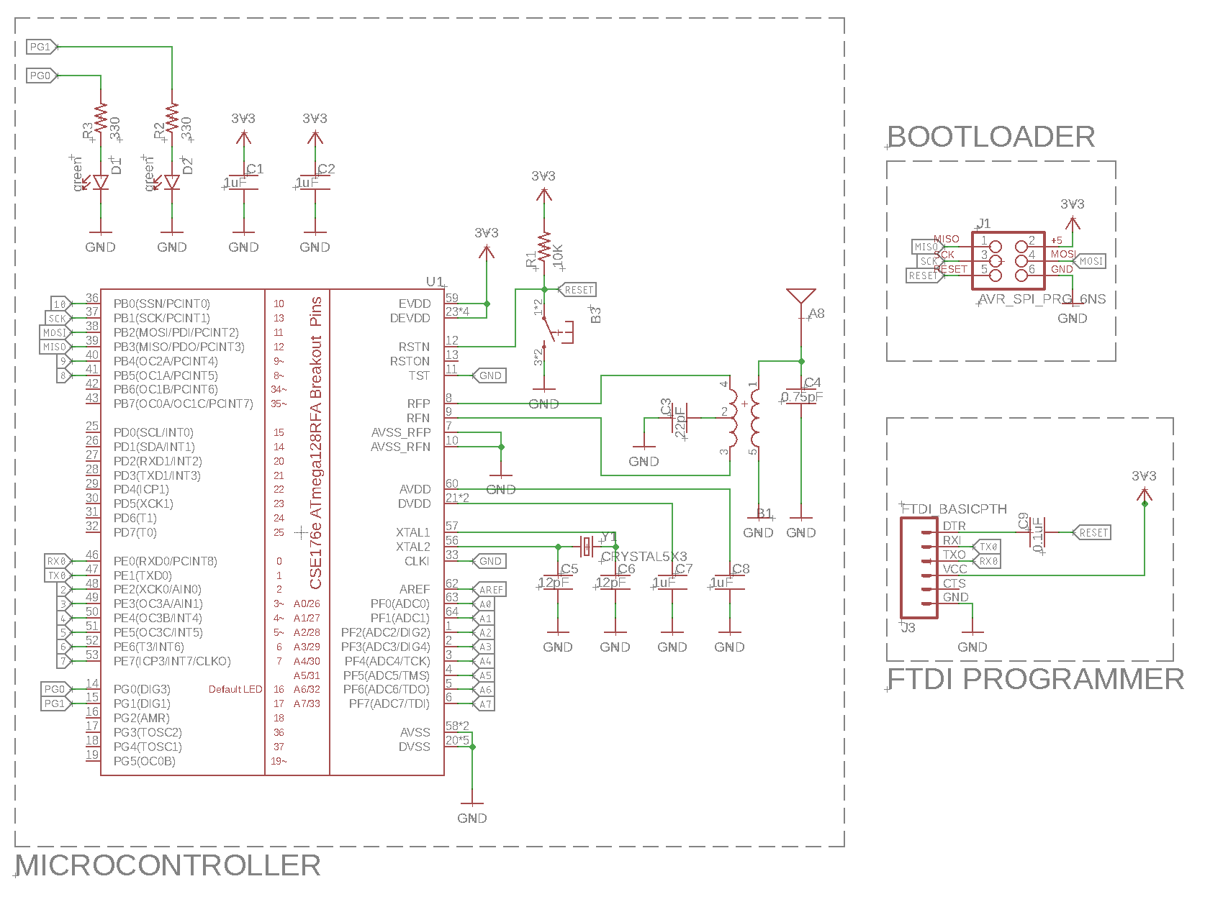
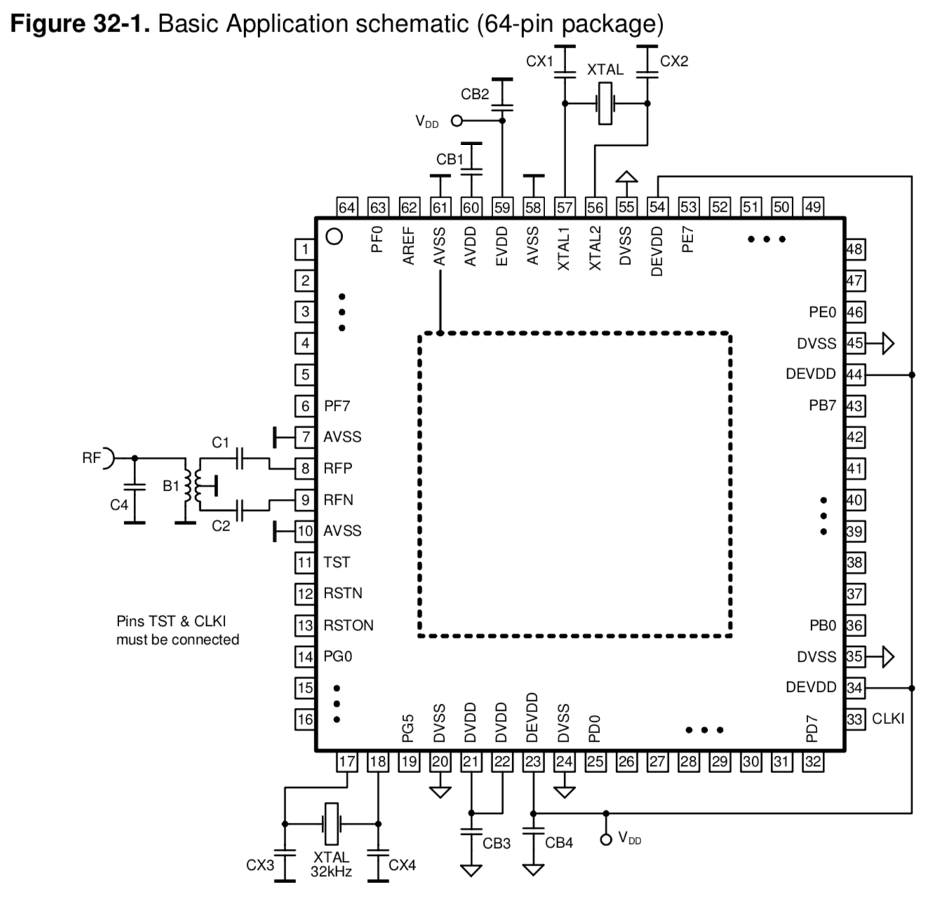
uController Datasheet and Reference Design

Slide 14
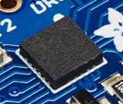
Inertial Measurement Unit
STMicro LSM9DS1
9-axis sensor
3-axis accelerometer
3-axis magnetometer
3-axis gyroscope
We will use the I2C interface

Slide 15
IMU datasheet
Notes
You can tie all the RES/GND pads to one pin on the schematic symbol

Slide 16
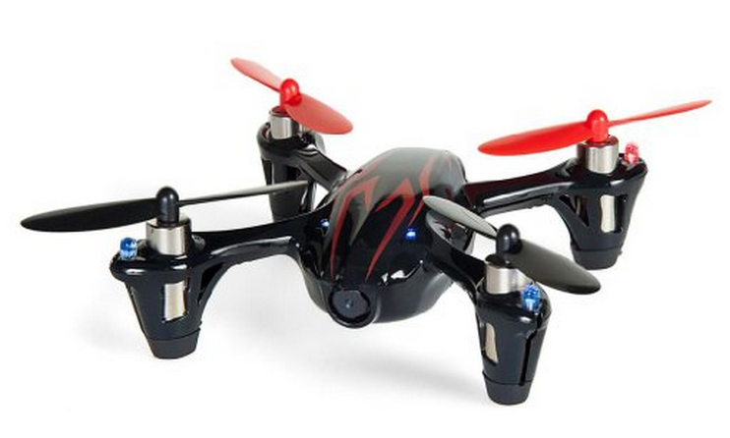
Motors and Props
Plenty of power
DC brushed motors
They draw ~2A each.

Slide 17
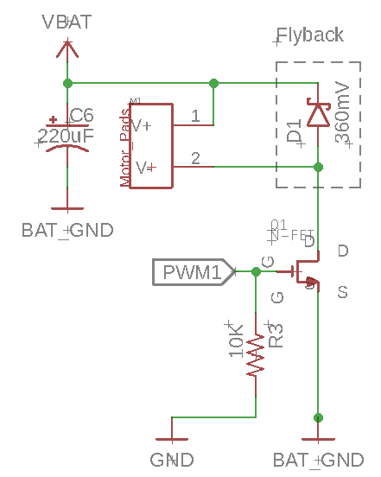
Motor Driver
Pulse-width modulation (PWM)-controlled MOSFET
The microcontroller will drive the MOSFET
The MOSFET will drive current to the motor.
A diode handles the inductive load from motor when it turns off
Pull down resistor so it defaults to ‘off’.
Large capacitor for “decoupling”

Slide 18
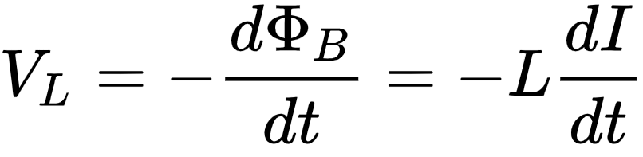
Motor Switching: Inductance and Flyback
Inductance
Resistance to a change in current
Intuitively, current takes time to start and stop flowing.
Imagine water flowing in a pipe, when you turn off the faucet.

Slide 19
Motor Switching: Inductance and Flyback
Motors are inductors (and resistors)
Motor voltage equation
Vm = voltage across the motor
I = Motor current
R = Motor resistance
L = Motor Inductance
dI/dt = rate of change of motor current

Slide 20
Motor Switching: Inductance and Flyback
Add a ‘fly back diode’
When the switch is closed
No effect (reverse-biased)
When the switch is closed
Forward-biased
Routes current back into the motor
Good videos
https://www.youtube.com/watch?v=6R_3jHeimiE
https://www.youtube.com/watch?v=m5JYkgCRbBI&t=1s

